Slide 1
Project 1 - Group 4
Chicago Rideshare & Taxi Service Analysis in 2020
Jason Miller, Thomas Dunn, Shail Desai,
Timothy Giles, Vanessa Ortiz, Luis Pineda

Slide 2

Summary
We run the Astros Taxi Company in Chicago, IL.
Our business has been struggling with maintaining business due to the explosion in popularity of ride share apps across large cities, including Chicago.
The City of Chicago tracks Taxi and Transportation Network Providers (“ride share”) data. Each row in the datasets represents one individual trip, containing info like timestamp, trip miles, fair, tips, etc.
The data is uploaded to the Chicago Data Portal, which is what was used for API call.
Additionally, we pulled a “Chicago” data set from GeoDataSets to create a map of Chicago. GeoDataSets was downloaded into the conda environment and included as dependency in the code.
We encountered an issue with calling the data and were able to resolve it by downloading the data as a CSV file and taking randomized samples.

Slide 3
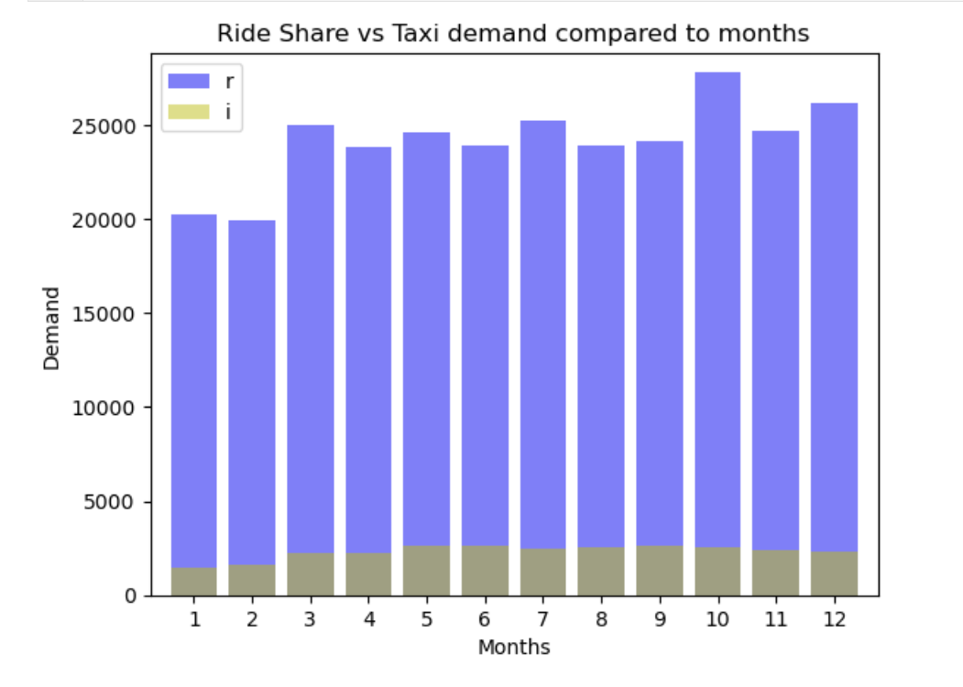
Taxi vs Ride Demand - What should you drive?
Using Bar-chart to compare the which is more popular method of transportation.
Based on the bar chart we can see that ride shares are way more popular compared to taxi in chicago throughout the year.
Other than first 2 months of the years. Total rides driven per month were consistent. There is a small spike in october for ride share.
The demand for it significantly higher for ride shares such as Uber or Lyft
Bar chart

Slide 4
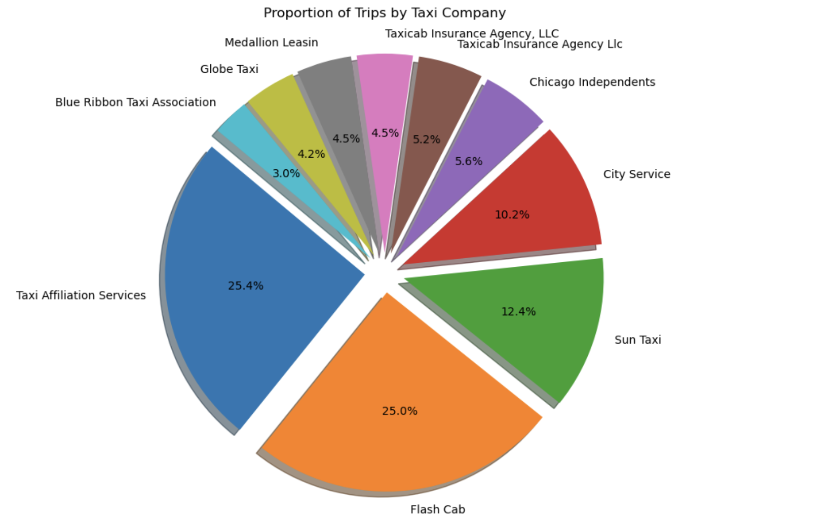
Taxi company popularity - Which company you should drive for?
Using pie-chart to figure which taxi services is more popular .
Based on our analysis Taxi Affiliation services and flash cab are the most popular company. Followed by Sun taxi and city services.
3 taxi company make up more than 50% of market share in chicago.
So if you want to drive a taxi in chicago. It will be a good choice to ride for TAS, Flash cab and Sun taxi.

Slide 5
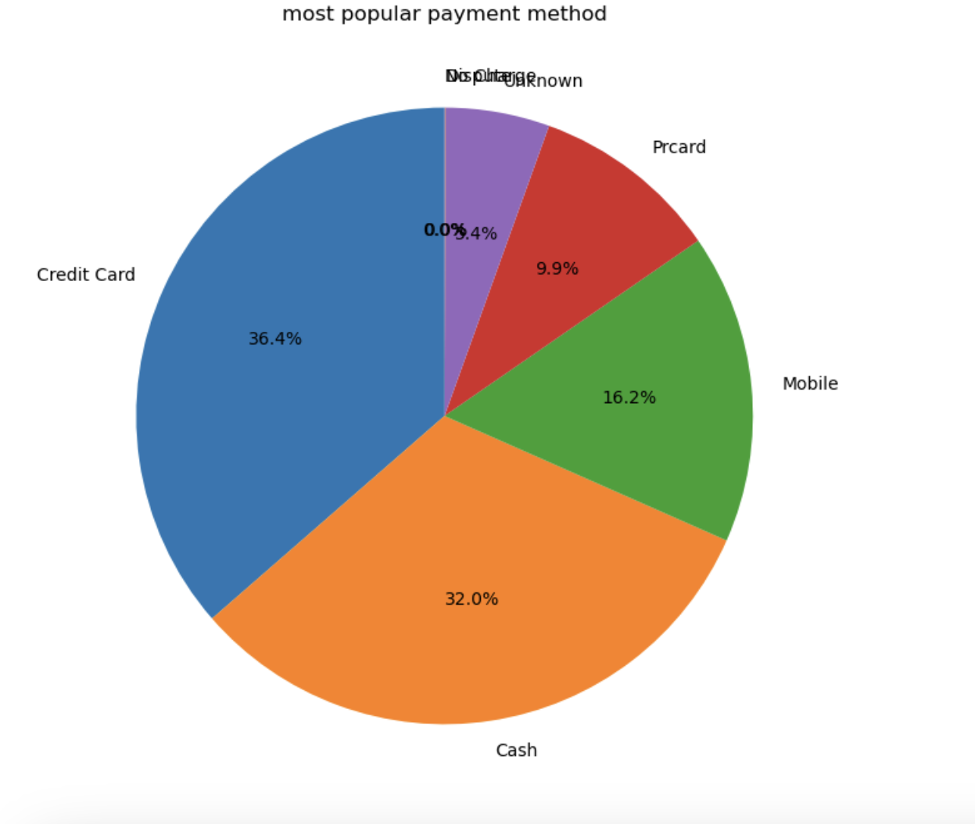
Taxi Payment- What payment method should you accept?
Using pie chart to show most used payment method for taxi.
Most people use their credit card as their payment method.
To appeal to majority of the population it is crucial that a taxi driver accept credit-card and cash as the form of payment method.

Slide 6
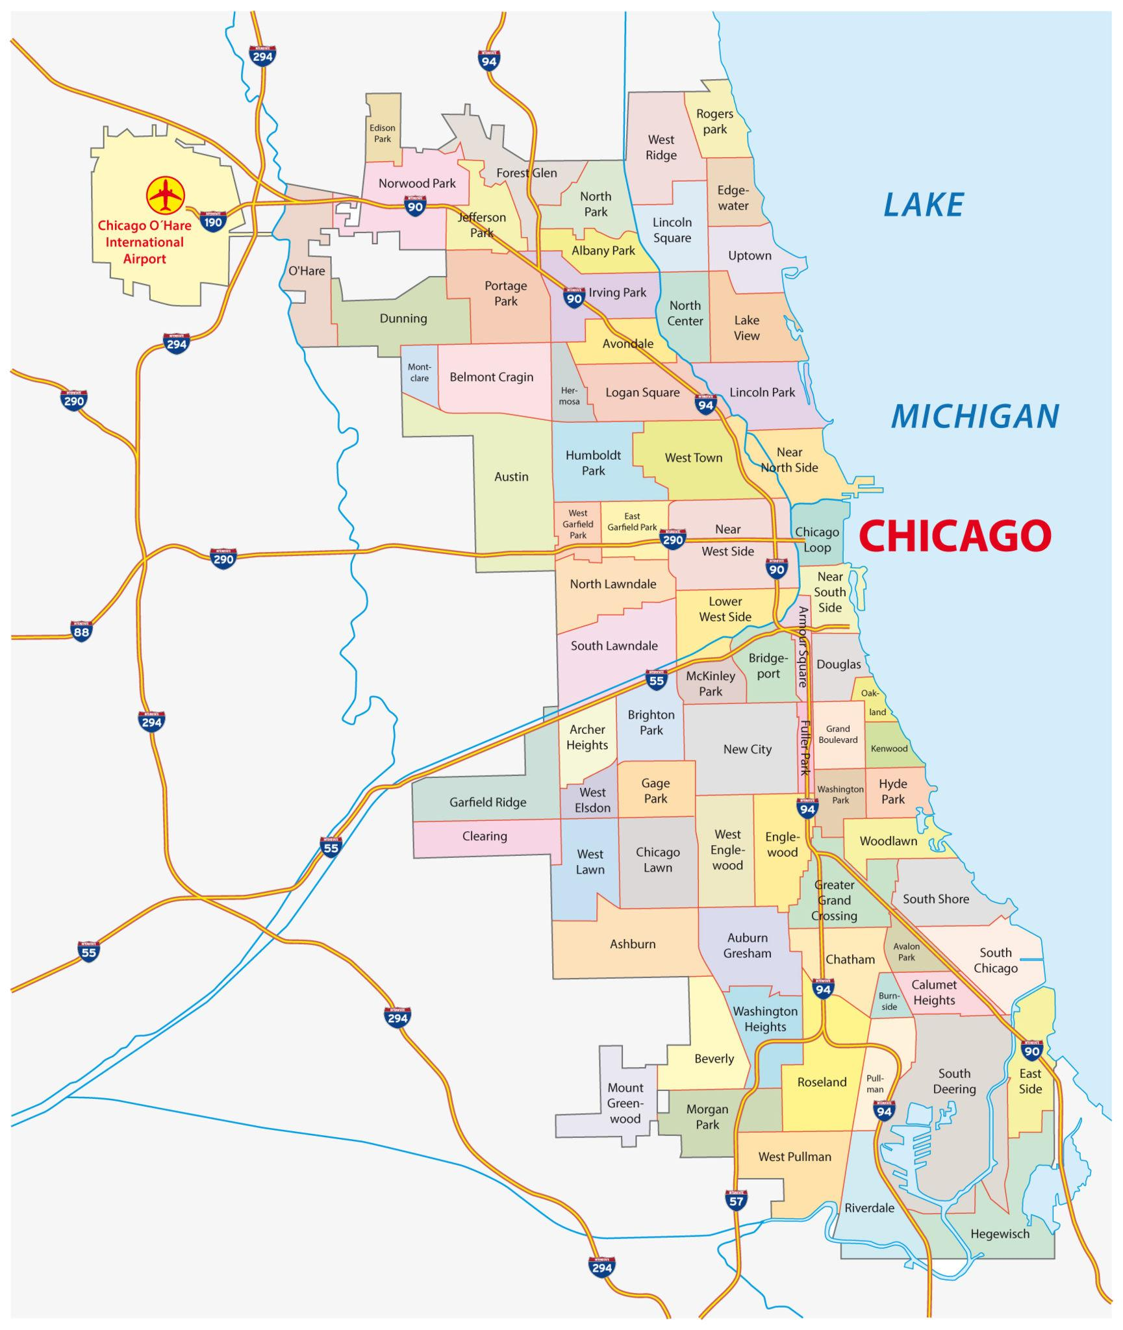
Pick Up Trends across Community Areas - Where should you drive?
The city of Chicago is split into Community Areas for governance purposes.
The data for both Ride Shares and Taxis listed the Community Area in which the customer was picked up.
We assumed that areas with higher population would result in a higher amount of rides as there would be more customers to order rides.
We want to use this info to know where we should allocate our drivers. The time between ordering a ride and being picked up should be short. Therefore we have to make sure we put drivers in areas where there is more activity so they can quickly get to the rider.

Slide 7
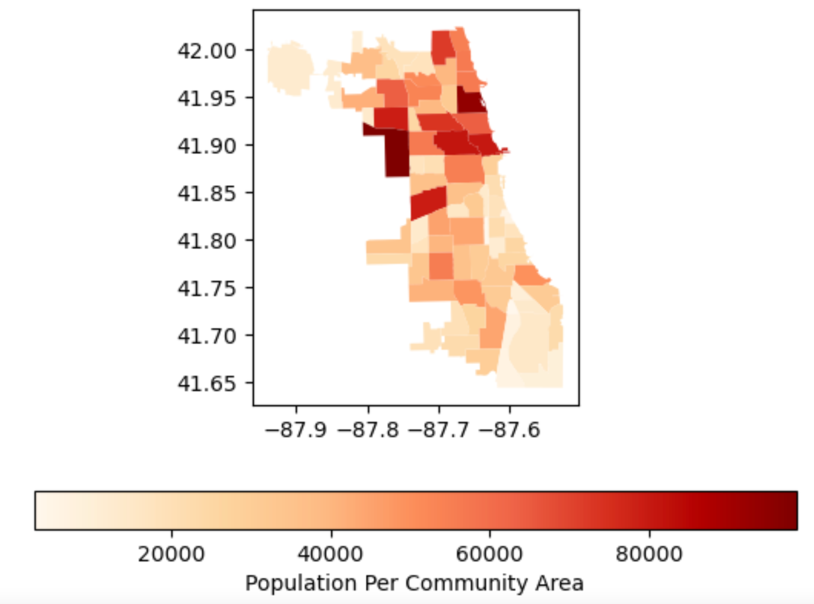
Population Heat Map - Where should you drive?
The Heat Map on the right shows population concentration per Community Area.
The dark region on the left is the Austin community area which is the most populous in Chicago.
The dark region on the right is Near North Shore, where downtown Chicago is located
Based on our assumption, both Austin and Near North Shore should have the highest number of rides

Slide 8
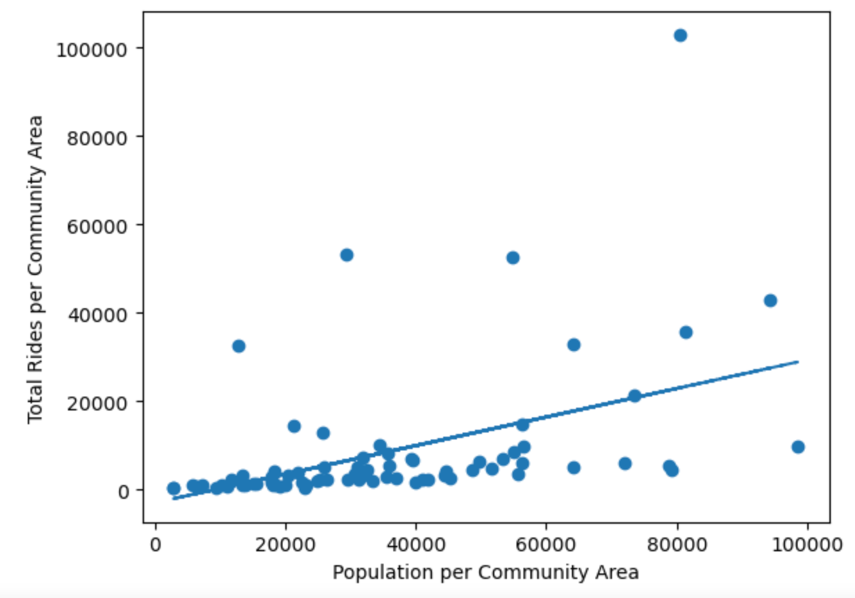
Comparing number of Rides to Population - Does population affect the demand for rides?
Scatter plot on the right shows the number of rides in relation to the populations in the community areas
Analysis resulted in a P-value of 2.0096e-05, meaning there is a strong correlation between the two variables

Slide 9
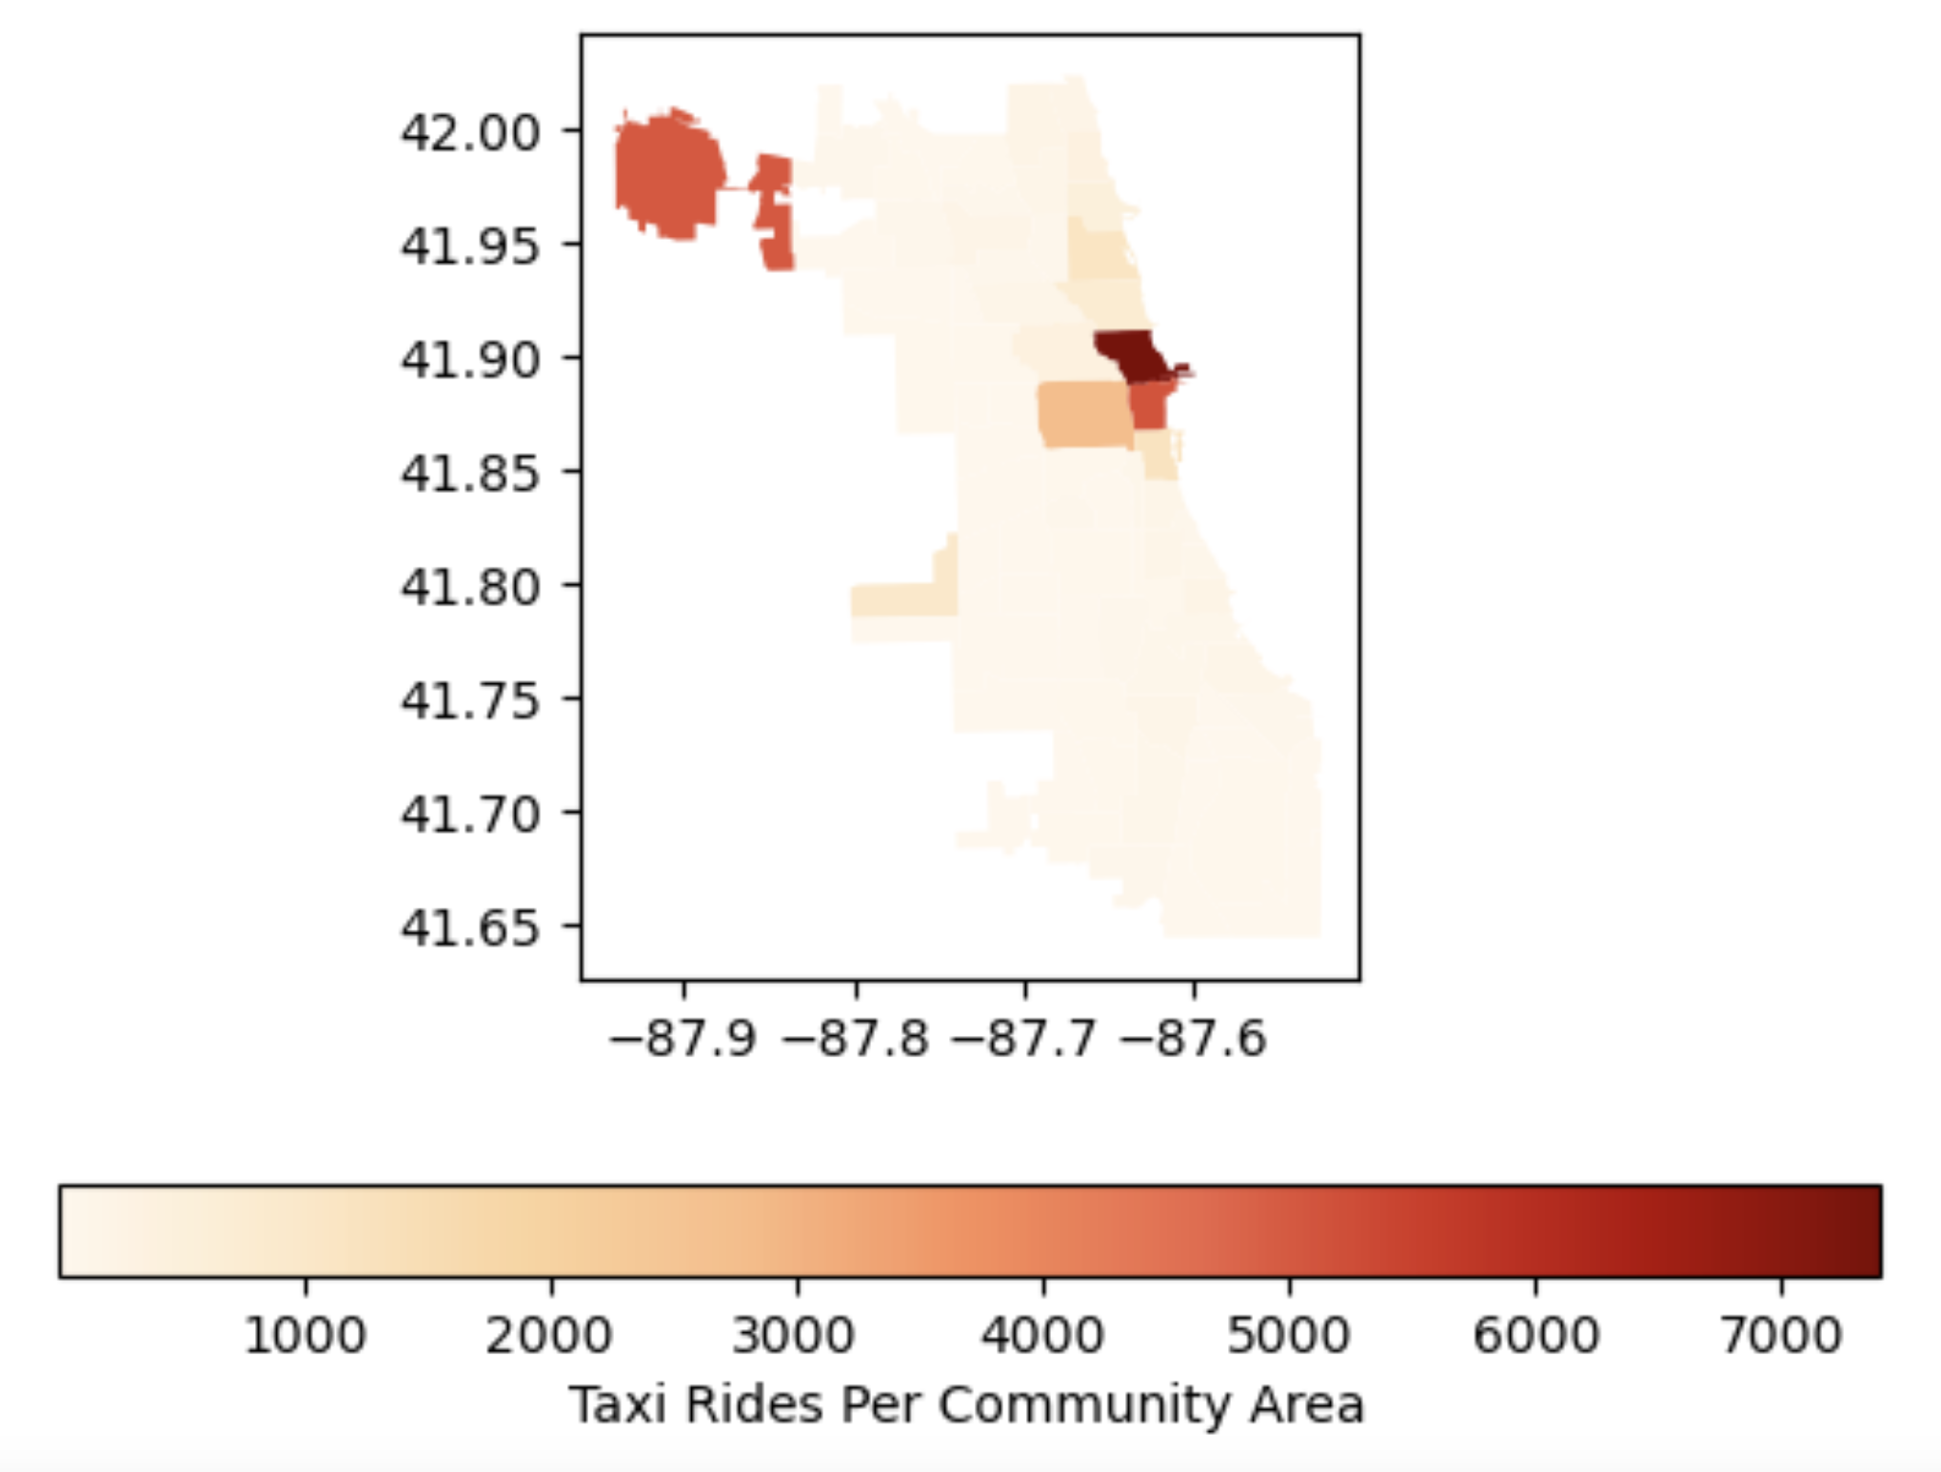
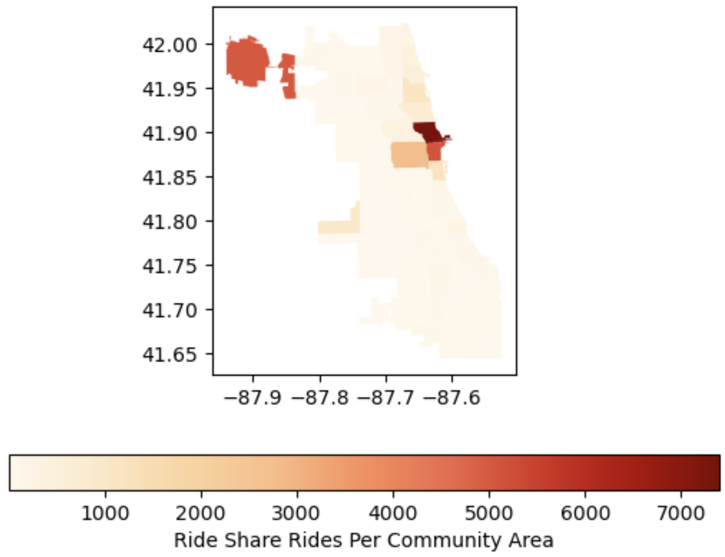
Almost identical usage across Community Areas

Slide 10
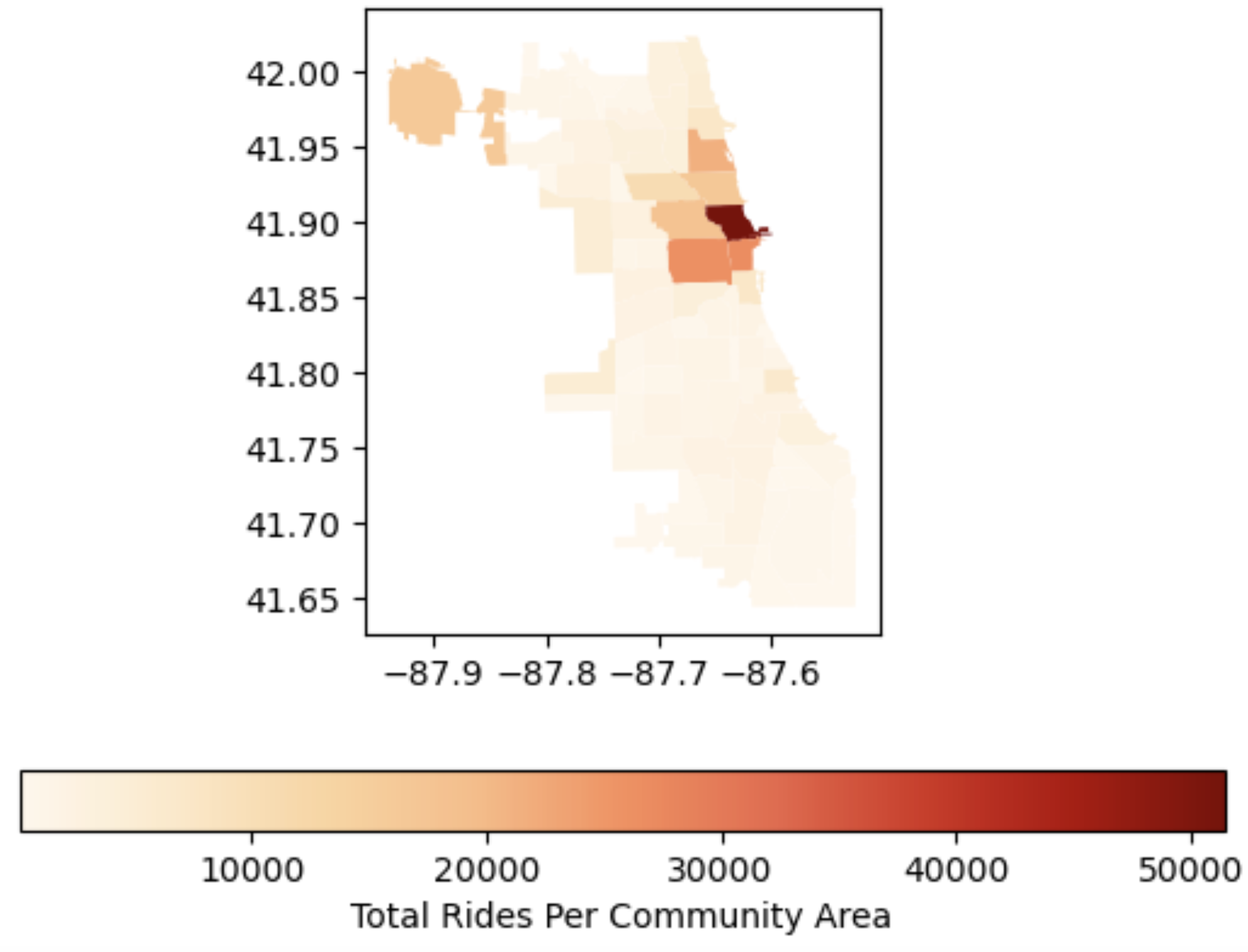
Total Rides per Community Area - Where is the demand?
Usage of both transports is concentrated in the downtown area, for the most part matching the population concentration.
Austin, despite having the largest population, did not have any where near the same ride amounts as downtown Chicago.
On the other hand, the O’hare area, which had one of the lowest populations, had a high pick up rate. This was probably due to the drivers picking up people arriving from Chicago’s O’hare Airport.

Slide 11
Rides to Population Conclusion -
Where to focus?
Although the pick up rate is closely correlated to population size, the more important factor should be accessibility to vehicles which is not as common in the center of highly populated cities like Chicago. Likewise, people arriving from another city would not have access to their own vehicle and order a ride through taxis or a rideshare app to get to their destination.
Drivers should be allocated to the area in the red oval as they would be able to focus on the areas with the highest pick up rates.

Slide 12
Pricing
We are reevaluating pricing to match market conditions and be competitive with what other taxi and rideshare services are charging.
For this, we aggregated the data across both the taxi and rideshare Data Frames.
Originally, we looked at the average fare per mile traveled and found that ride services were charging an average of $5.40 per mile.
Charging a fee per mile would result in inordinately high prices as the trip distance increased.
The ride from downtown to O’Hare Airport would cost $84.55, which would be incredibly high.

Slide 13
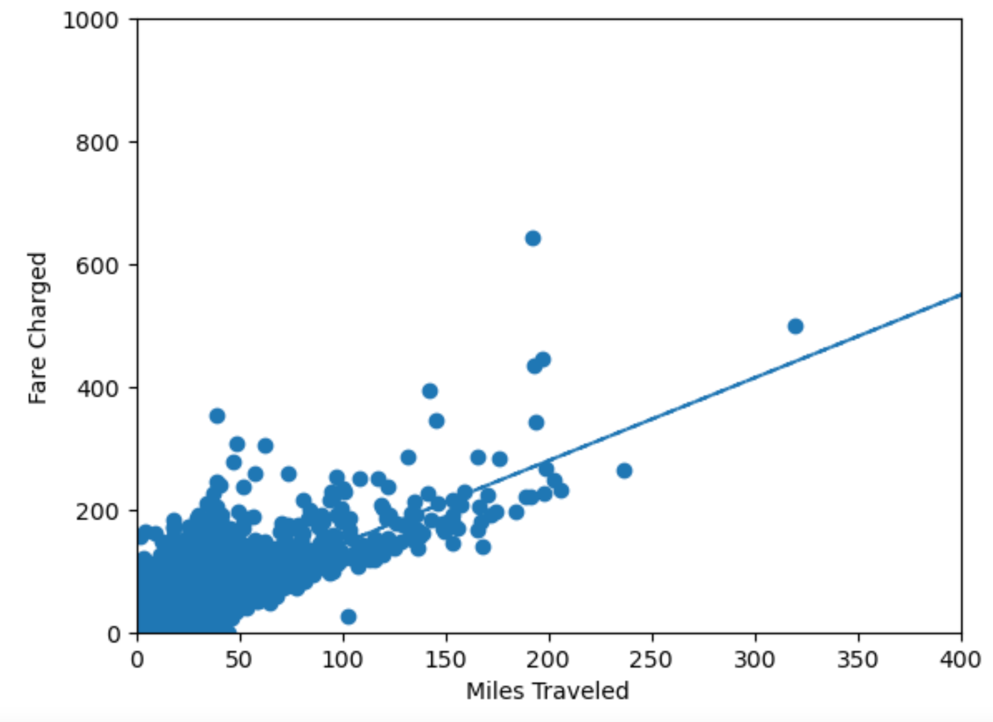
Pricing (cont.)
Through our research we found that ride services use a pricing method which includes a flat rate for the ride along with a variable rate based on the miles travel.
We came up with the solution of graphing the Fare Charged and Miles Travel on a scatter plot. Then a linear regression was applied to the scatter plot.
The linear equation is used as a proxy for that pricing equation.
The result is a $9.49 flat fee per ride, along with a rate of $1.35 per mile traveled

Slide 14
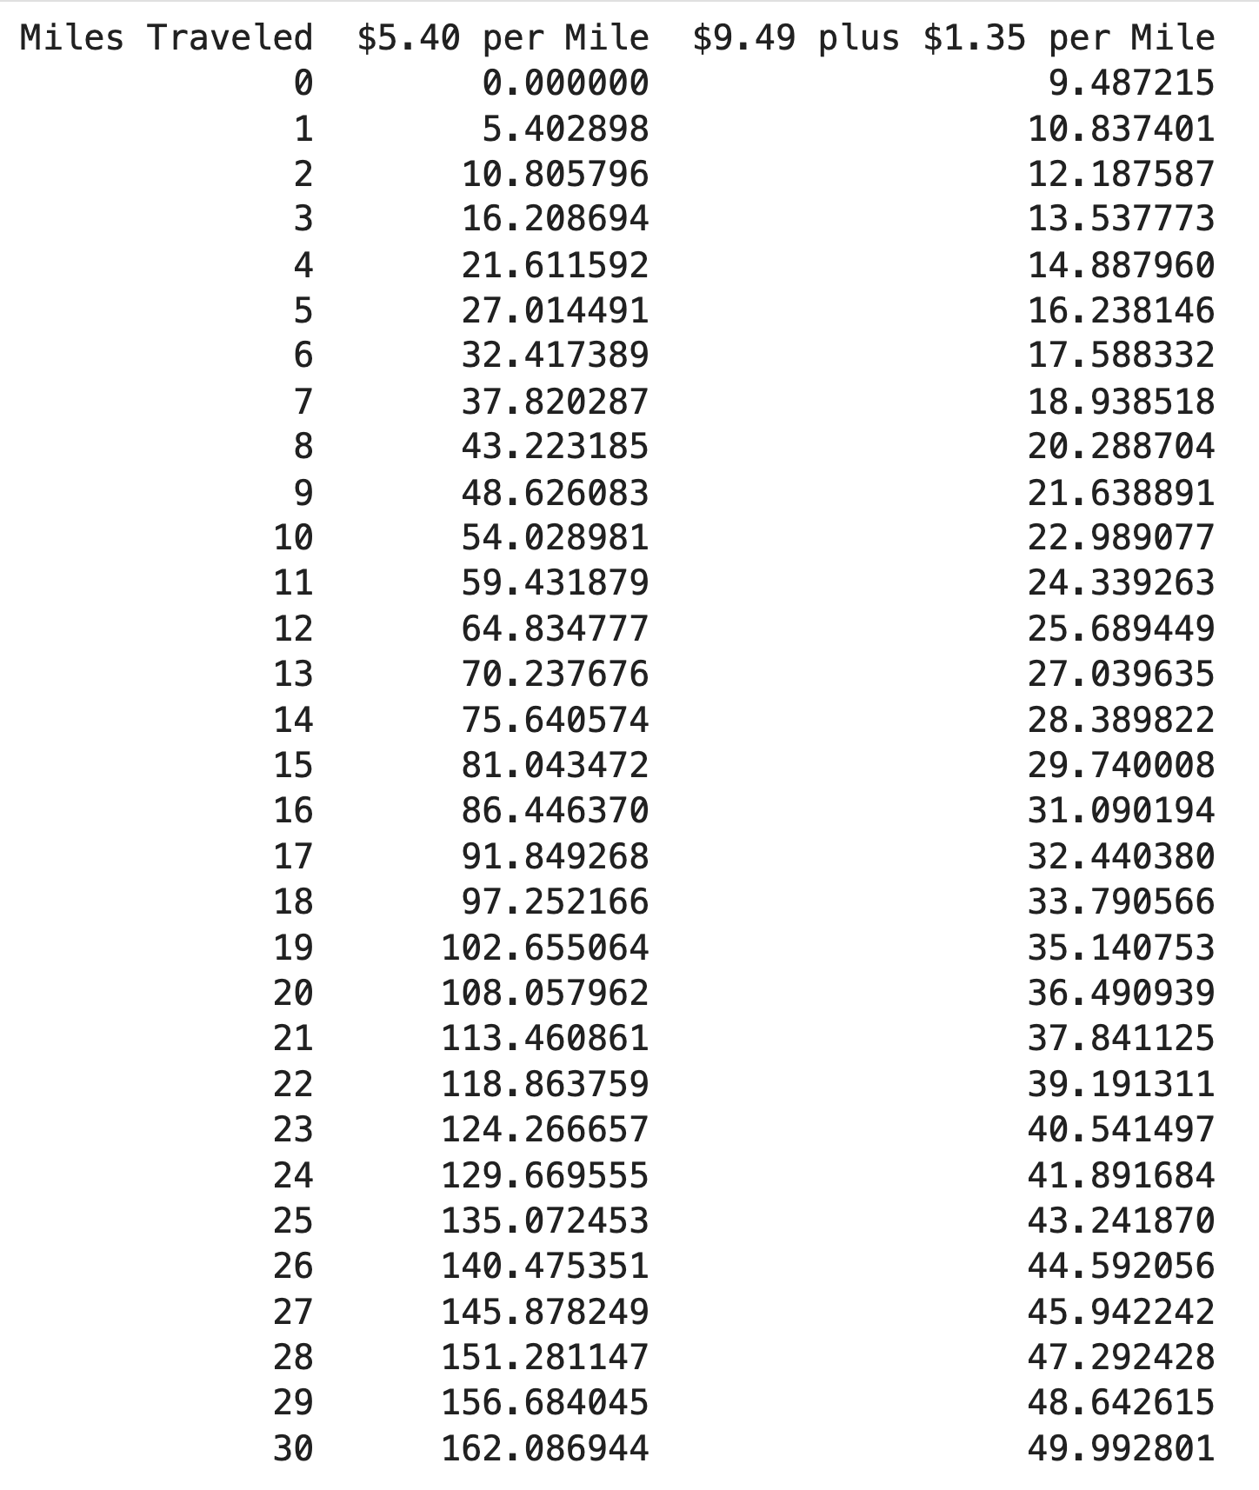
Pricing Conclusion
The table on the right shows the result of both pricing methods. As you can see, using the flat plus variable rate pricing method leads to a more reasonable price for the rider.
Additional variables could be added to further modify the equation.

Slide 15
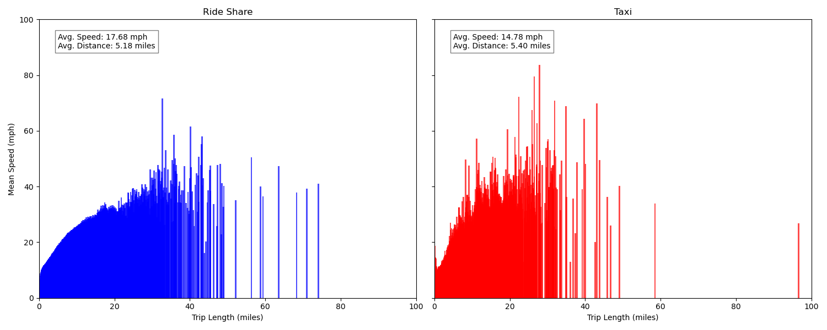
Comparing Rideshare Services and Taxi Speeds -
Who drives faster?
The average speed is for the entire trip including time not moving. On average rideshare services are slightly faster than taxis.

Slide 16
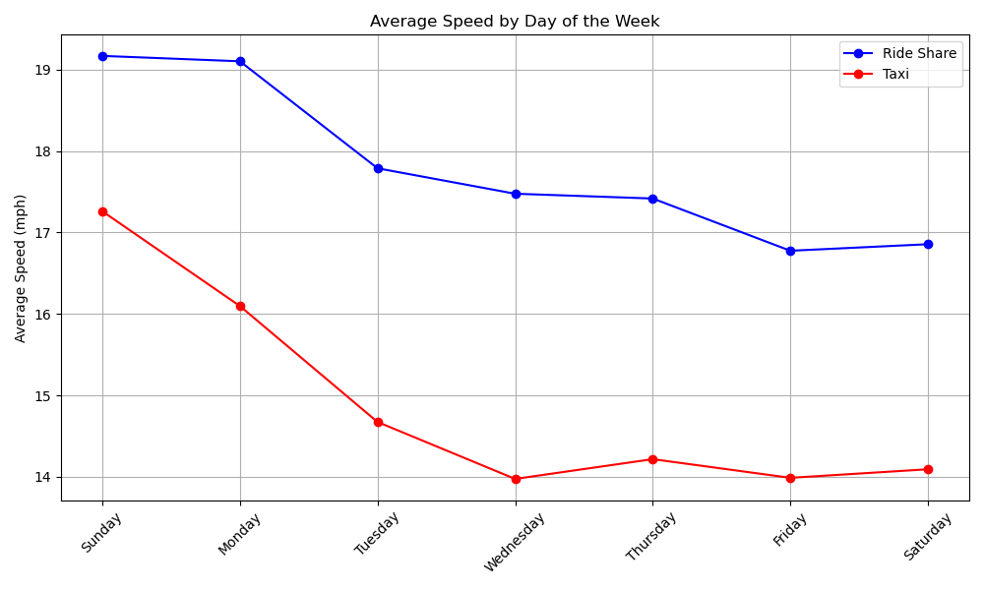
Speed by Day of the Week - Who drives faster?
Travel speeds average 2 to 3 mph faster on Sunday and Monday, presumably because of less traffic.

Slide 17
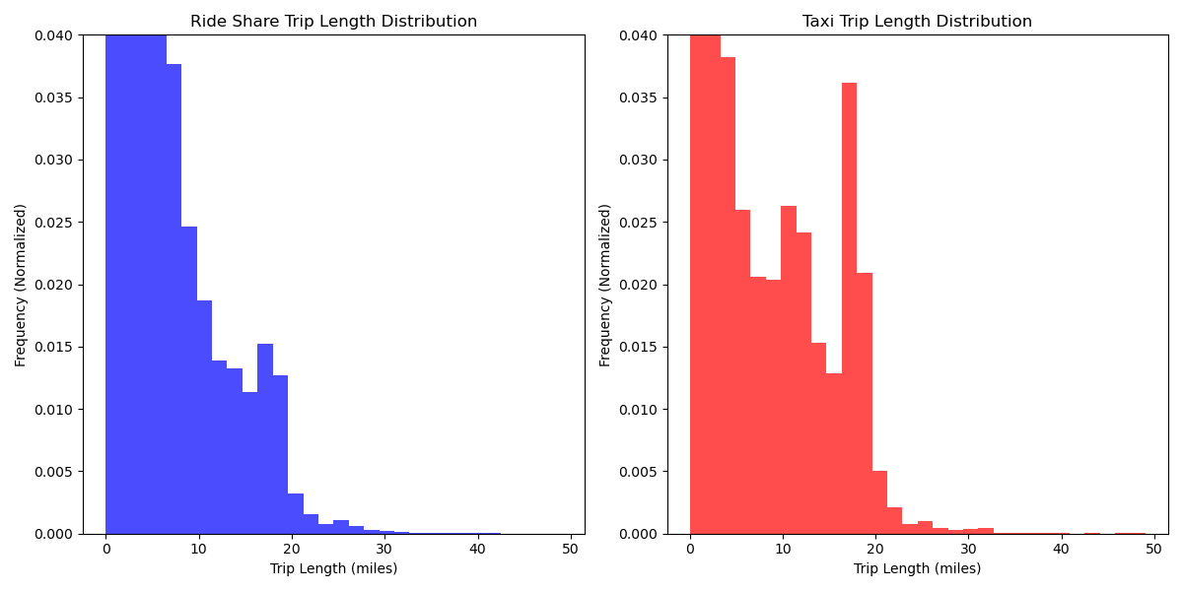
Trip Length Distribution - Who drives more?
Both datasets are heavily skewed towards shorter trips, with a bump at 20 miles.
The bump at the 20 mile mark is more pronounced in the taxi data. The airport is also a 20 mile drive from downtown, which is again suggesting that taxis should be focusing on the airport and downtown.

Slide 18
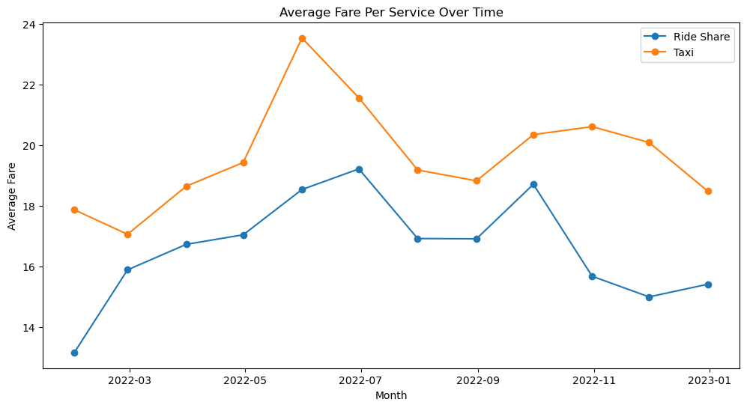
Analyze Fare Amounts Between Rideshare and Taxi Over Time
Average fare amount for both services is higher during high seasons.
July: 4th of July, Lollapalooza
November: Thanksgiving Day Parade
Taxi fare on average could be higher than rideshare due to operation costs
Average fare amount for taxi services has increased over time, but at a slower rate than for ride share services
Rideshare services are becoming more popular, higher demand, higher fares.
Cost of operating rideshare services is increasing
Taxi drivers are facing competition from rideshare services

Slide 19
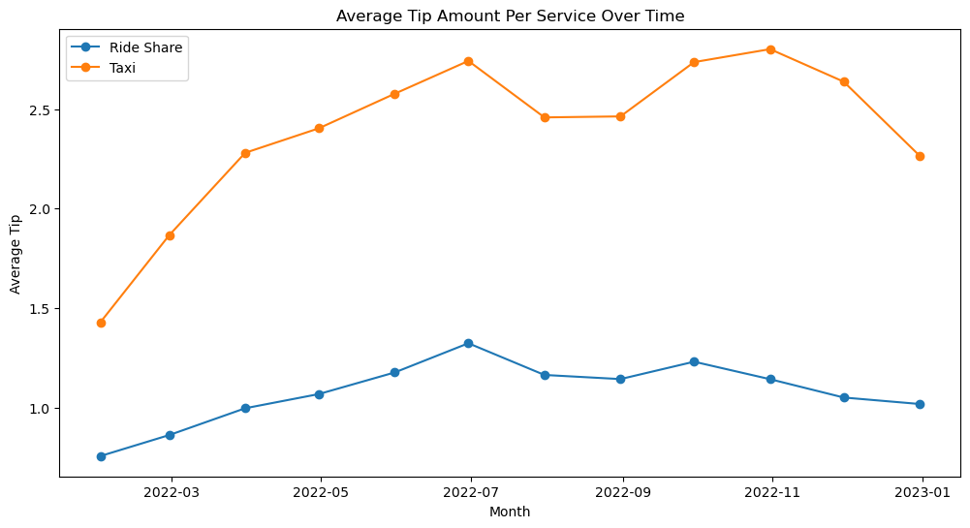
Analyze Tip Amounts Between Rideshare and Taxi Over Time
Average Tip for both services is higher during high seasons.
July: 4th of July, Lollapalooza
November: Thanksgiving Day Parade
The increase in the average tip amount for ride share services may be due to a number of factors: convenience, perception of service, or expectations that riders have for the level of service provided by rideshare drivers.
The increase in the average tip amount for taxi services may be due to a number of factors: rise in the cost of living, increasing competition, or desire to provide a more competitive service
Taxi’s average could be higher because of a smaller population sample, regulations, operating costs, and demand

Slide 20
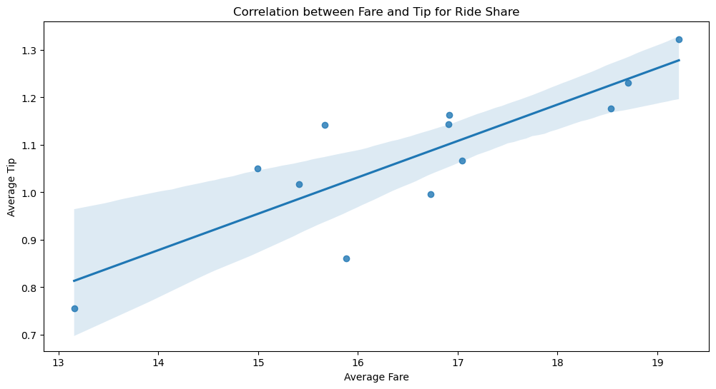
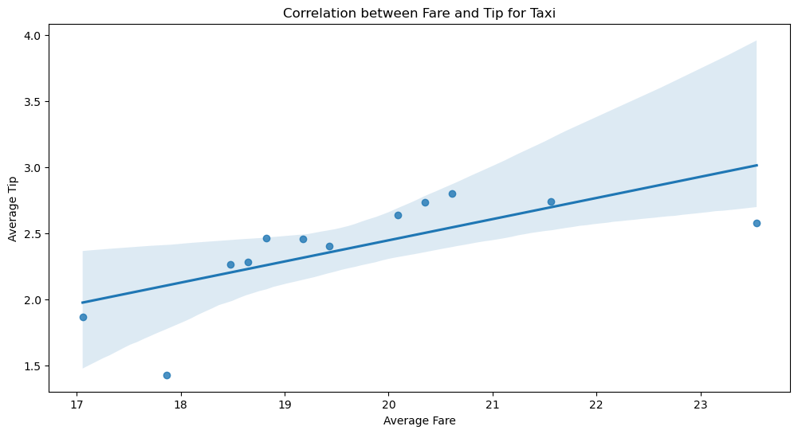
Determining Correlation Between Average Fare and Average Tip -
Does the tip amount increase with the increase in fare amount?
Visualize results using a scatter plot with line of best fit

Slide 21
Results
For Ride Share, the correlation coefficient is 0.843 (approximately), which indicates a strong positive correlation between the average fare and the average tip. The p-value is about 0.000575, which is less than 0.05, a common threshold for statistical significance. This suggests that the observed correlation is statistically significant, and it's very unlikely that it's due to chance. You would reject the null hypothesis of no correlation between the average fare and average tip for Ride Share.
For Taxi, the correlation coefficient is 0.703 (approximately), which indicates a moderate positive correlation between the average fare and the average tip. The p-value is about 0.01082, which is also less than 0.05, indicating that the observed correlation is statistically significant, and it's unlikely that it's due to chance. You would also reject the null hypothesis of no correlation between the average fare and average tip for Taxi.

Slide 22
Conclusions
Through our research, we’ve been able to find:
Demand by month: Routine fleet maintenance can be scheduled for Jan and Feb as those are the days with the lowest demand. There is no specific time of the year where a ride share drive or taxi driver can earn more.
Most popular payment methods: It was surprising to see cash was still a popular form of payment, therefore taxi services should keep accepting cash to not alienate customers that pay with cash.
The Heat map shows us what areas of Chicago have the highest demand and therefore, where we should focus our drivers.
Average fare amount per month per service showed a gradual increase in fare amount for both services, with a larger annual increase for ride share services.
Average tip amount per month per service showed a gradual increase in tip amount for both services, with a large dip in tips near end of year for taxi services.
There is likely statistical significance between fare price and tip with a strong positive correlation.
Extensive info to compare rideshare apps versus taxi services to further modify our business model.

